Slide 1

Capstone project
Presented by
Sayantan Saha
Shubham Patnaik
Sulekha Jash

Slide 2



Meet our team
Sayantan Saha
Sulekha Jash
Shubham Patnaik

Slide 3
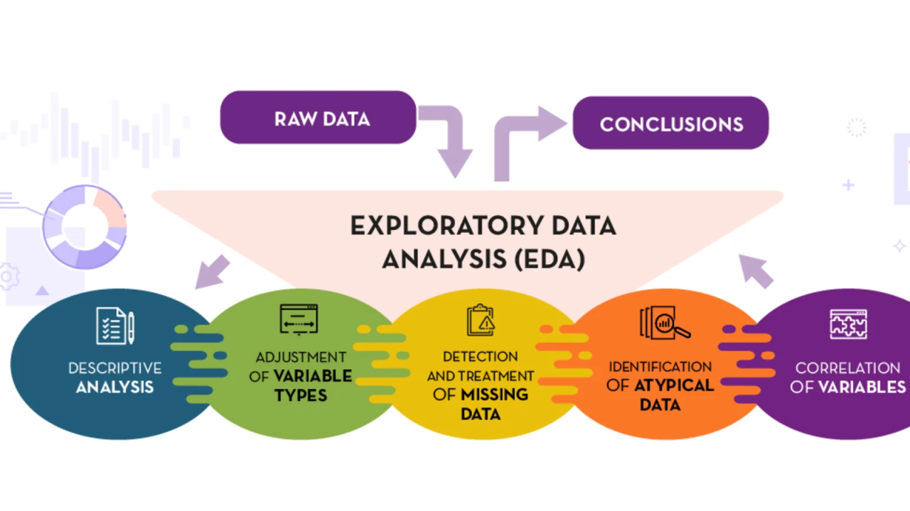

Slide 4


Slide 5
Project Overview And Objective
Project Overview
This project analyzes HR employee data using Python to understand employee demographics, salary, performance, promotions, and attrition. The analysis uses data visualization and statistical techniques to identify patterns that support better HR decision-making.
Project Objectives
Analyze employee demographics and salary trends.
Measure and understand employee attrition.
Identify factors affecting promotions and retention.
Explore relationships among HR variables using visualizations.
Provide insights to support data-driven HR decisions.

Slide 6
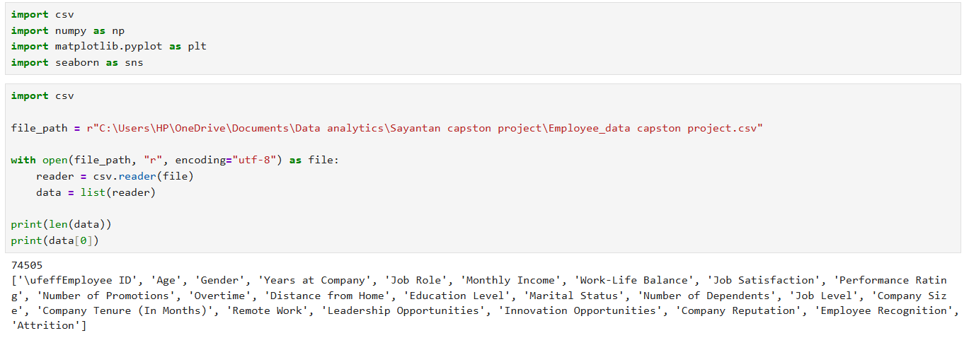

Slide 7
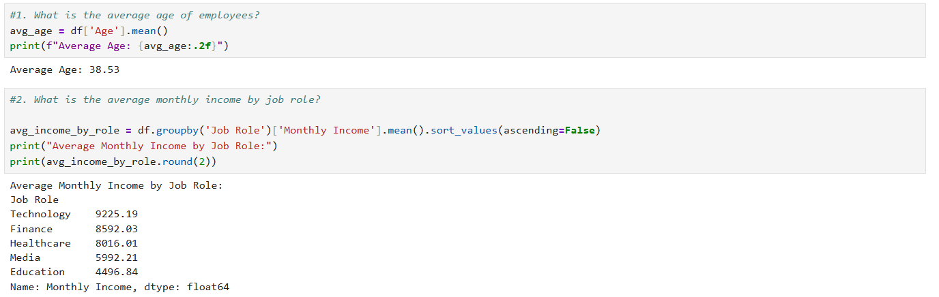
What is the average age of employees?
Business Insight
Based on my analysis, the average age represents the overall workforce profile and helps understand the organization's employee demographics.
Analysis - Univariate
Business Conclusion
I conclude that knowing the average employee age supports workforce planning, recruitment, and succession planning.

Slide 8
What is the average monthly income by job role?
Business Insight
My analysis shows that average monthly income varies across different job roles based on responsibilities and experience.
Business Conclusion
I conclude that salary differences across job roles reflect organizational hierarchy and compensation policies.
Analysis - Bivariate

Slide 9
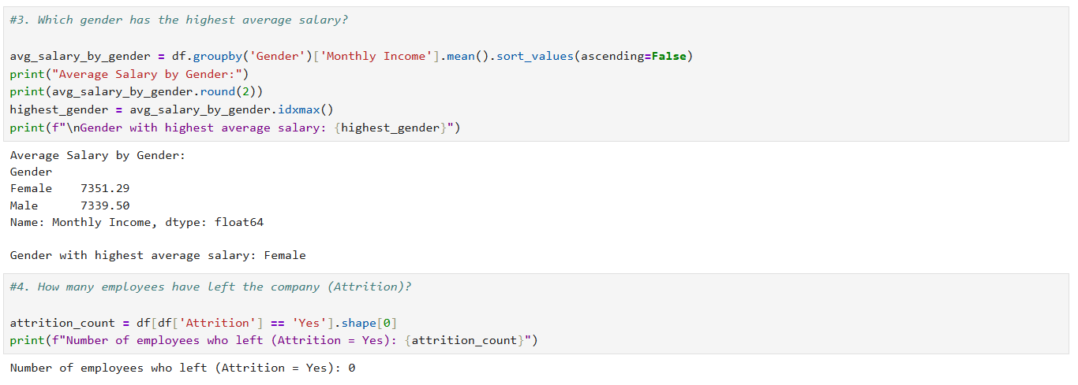
Which gender has the highest average salary?
Business Insight
Based on my analysis, I compared the average salary across genders to understand salary distribution.
Business Conclusion
I conclude that this comparison helps evaluate salary fairness and supports equal pay initiatives.
Analysis - Bivariate

Slide 10
How many employees have left the company (Attrition)?
Business Insight
My analysis identifies the total number of employees who have left the organization.
Business Conclusion
I conclude that monitoring employee attrition is essential for improving workforce stability.
Analysis - Univariate

Slide 11

What is the average work-life balance score?
Analysis - Univariate
Business Insight
The average work-life balance score reflects employees' overall perception of balancing work and personal life.
Business Conclusion
I conclude that maintaining a healthy work-life balance improves employee satisfaction and productivity.

Slide 12
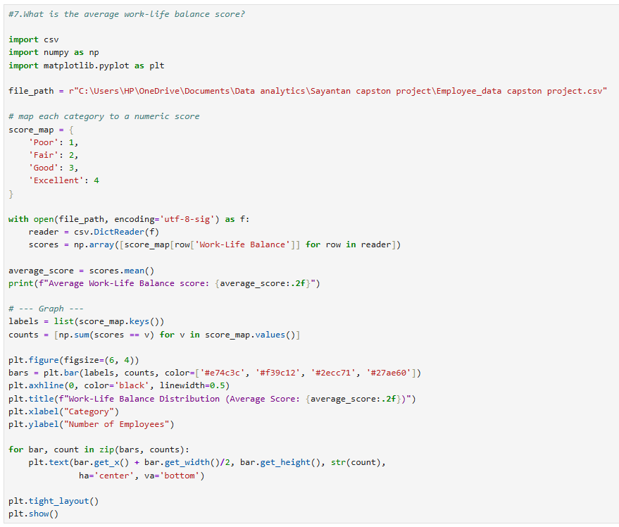

Slide 13
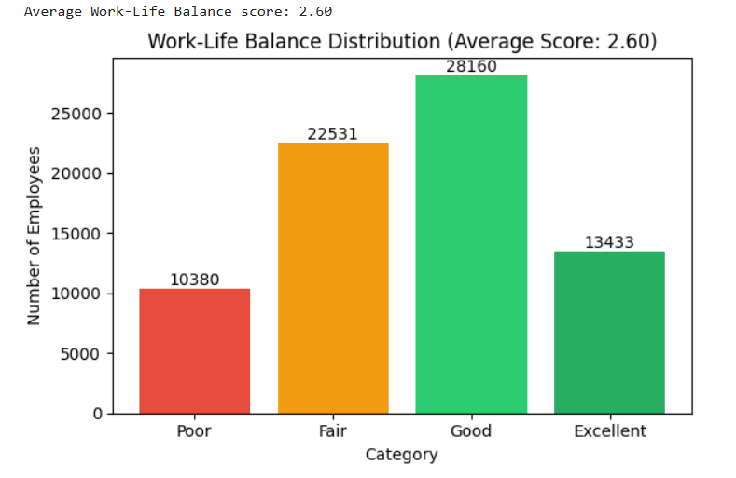

Slide 14

Plot the distribution of monthly income
Analysis - Univariate
Business Insight
Based on my analysis, I observed that most employees fall within a specific monthly income range, while only a small number receive significantly higher salaries. This indicates that the organization's workforce is concentrated in similar salary brackets.
Business Conclusion
I conclude that understanding the income distribution helps the organization evaluate salary structures, identify pay gaps, and develop fair compensation policies.

Slide 15
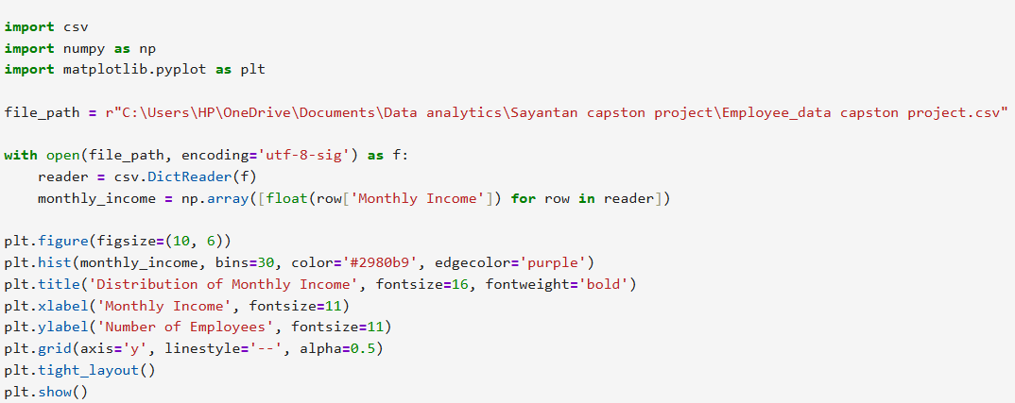

Slide 16
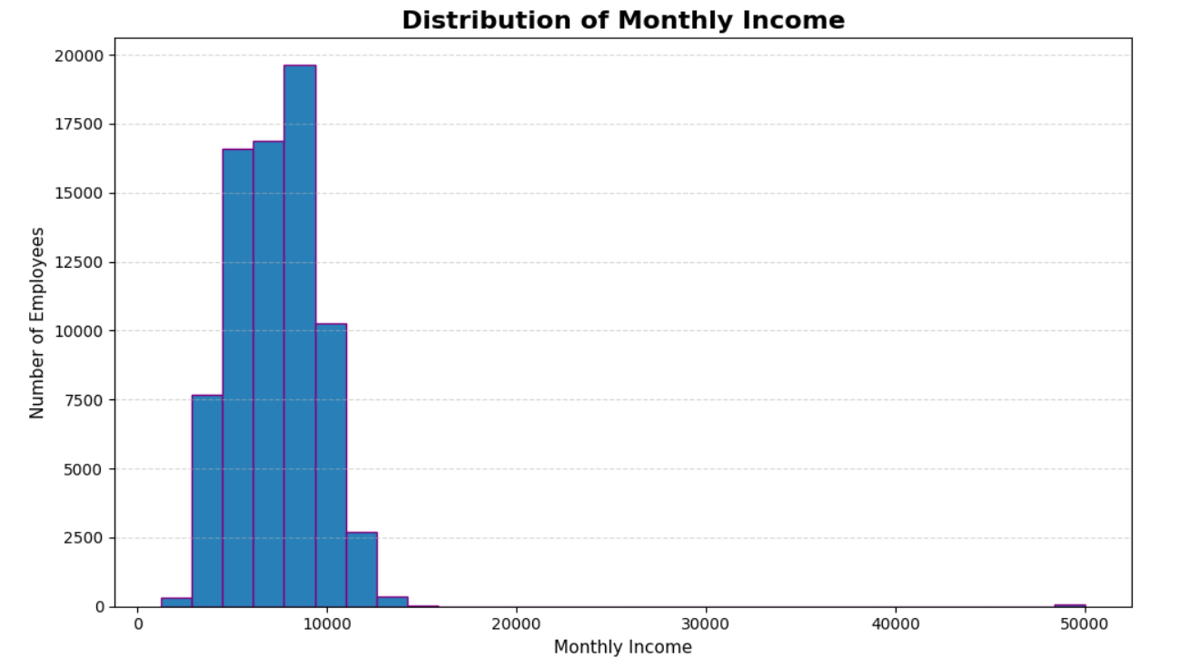

Slide 17

Shubham Analysis

Slide 18

Does overtime increase employee attrition?
Analysis - Bivariate
Business Insight
Overtime may increase employee stress and turnover.
Business Conclusion
The company should manage overtime to improve employee retention.

Slide 19
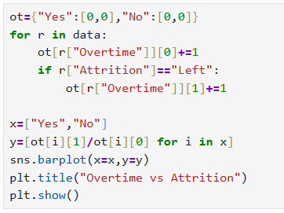
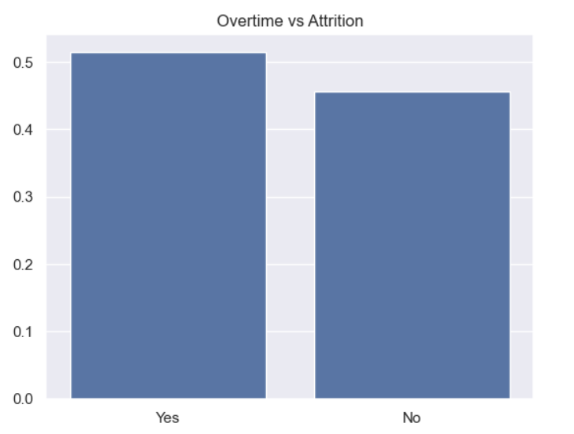

Slide 20

Does monthly income increase with Job Level ?
Analysis - Bivariate
Business Insight
Higher job levels are associated with higher income.
Business Conclusion
The salary structure supports career growth and fair compensation.

Slide 21
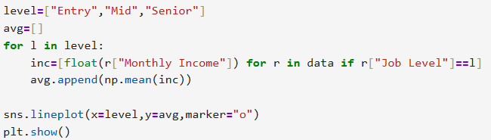
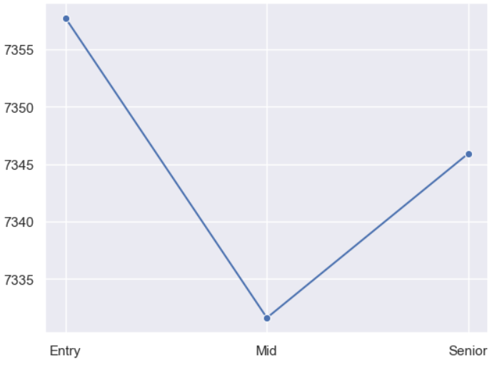

Slide 22

Which job roles have the highest attrition rates?
Analysis - Bivariate
Business Insight
Some job roles face higher employee turnover.
Business Conclusion
HR should focus on those job roles to improve employee retention.

Slide 23
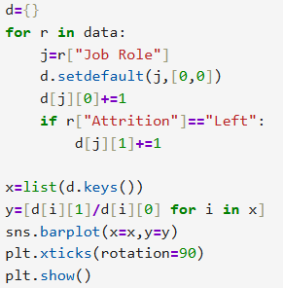
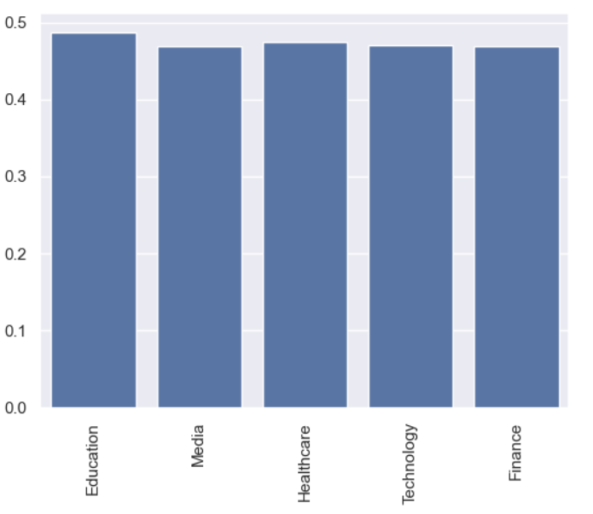

Slide 24

How does distance from home affect employee attrition?
Business Insight
Distance is not the only reason employees leave.
Business Conclusion
HR should consider other factors along with commuting distance.

Slide 25
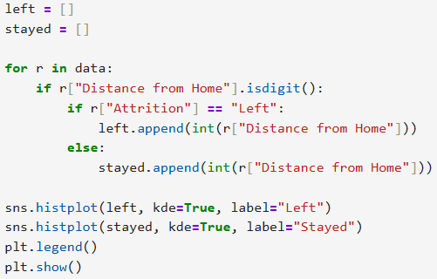
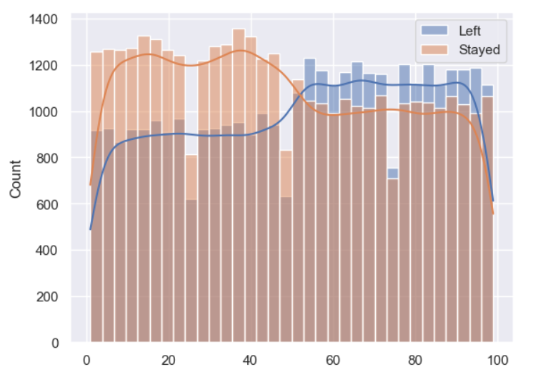

Slide 26

Does remote work reduce employee attrition?
Analysis - Bivariate
Business Insight
Remote work may improve employee retention.
Business Conclusion
Providing flexible work options can help reduce attrition.

Slide 27
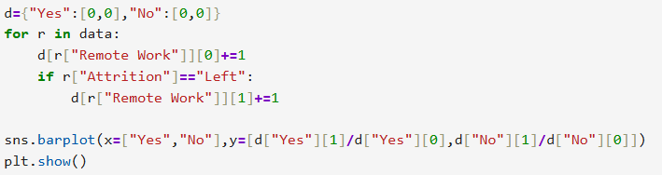
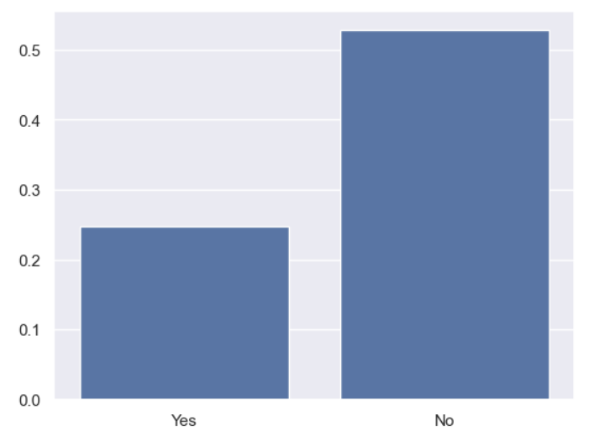

Slide 28

Plot age distribution by attrition status
Analysis - Bivariate
Business Insight
Different age groups have different attrition patterns.
Business Conclusion
HR should create age-specific retention strategies.

Slide 29
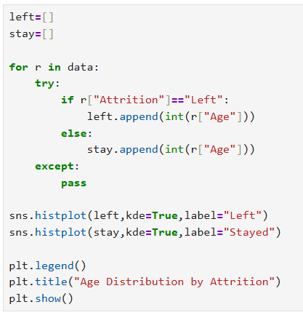
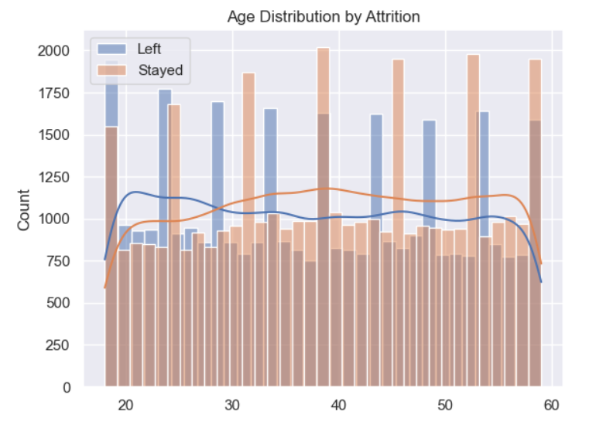

Slide 30
Sulekha Analysis

Slide 31

Which factors are most strongly correlated with attrition?
Analysis - Multivariate
Business Insight
Overtime shows a relatively stronger relationship with attrition than monthly income, suggesting that workload may have a greater impact on employee turnover.
Business Conclusion
Overall, the heatmap provides valuable insights into employee attrition and helps HR make more informed, data-driven decisions.

Slide 32
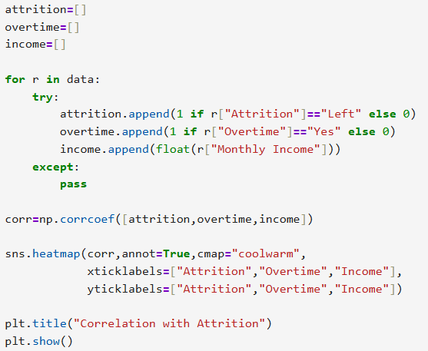
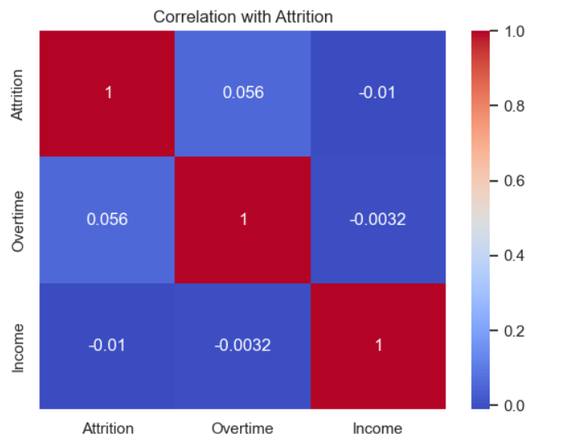

Slide 33

Do employees with leadership opportunities receive more promotions?
Analysis - Bivariate
Business Insight
Leadership opportunities may support career growth, but promotions also depend on other factors such as performance, experience, and skills.
Business Conclusion
In conclusion, leadership opportunities are helpful for employee development, but they are not the only factor that influences promotions.

Slide 34
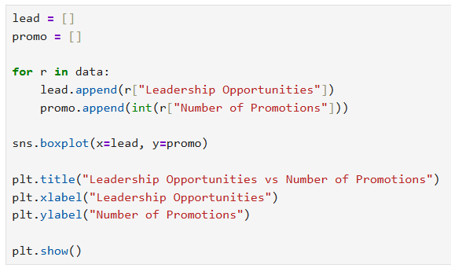
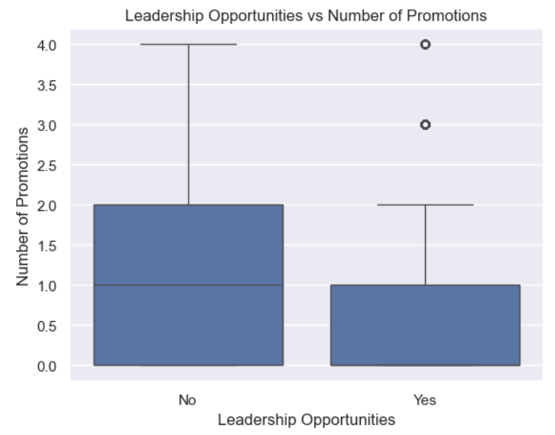

Slide 35

Does company reputation affect employee retention?
Analysis - Bivariate
Business Insight
A positive company reputation increases employee trust, satisfaction, and loyalty, which helps reduce attrition.
Business Conclusion
I conclude that maintaining a strong company reputation is important for improving employee retention and reducing turnover.

Slide 36
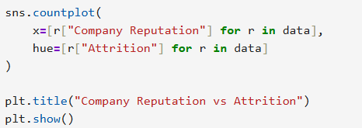
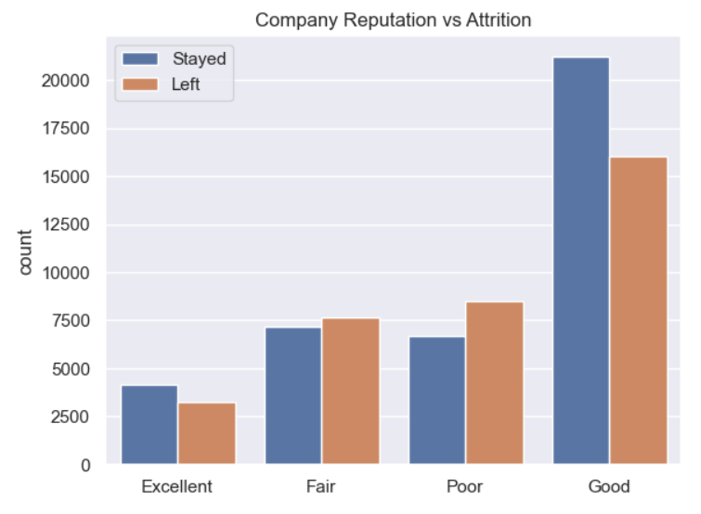

Slide 37

Are performance ratings related to monthly income?
Analysis - Bivariate
Business Insight
Employees who perform well are often rewarded with better compensation, which helps motivate them and improve productivity.
Business Conclusion
I conclude that performance rating is an important factor in employee compensation. Organizations should maintain fair performance evaluation systems to ensure deserving employees receive appropriate salary growth.

Slide 38
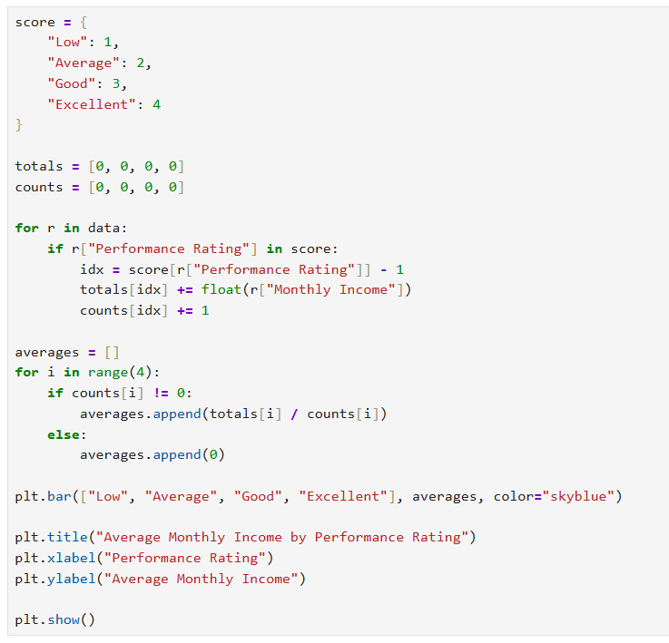
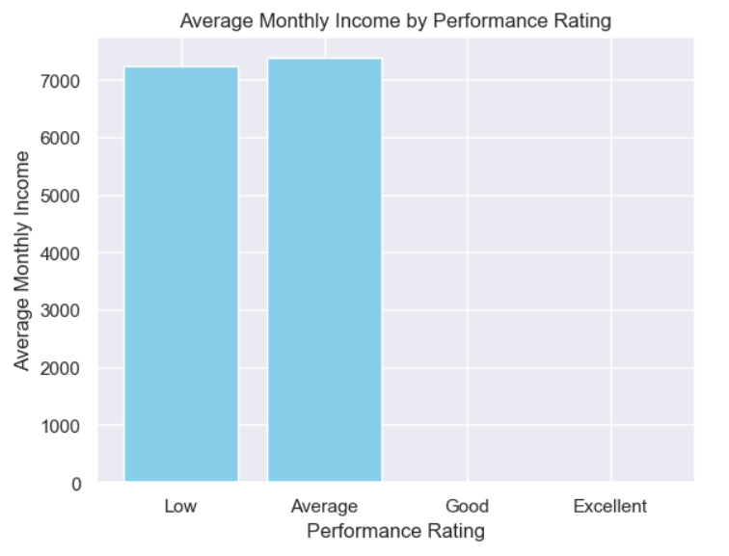

Slide 39
Which factors most influence employee promotions?
Analysis - Multivariate
Business Insight
Employee performance plays an important role in promotion decisions. Higher-performing employees are more likely to be promoted.
Business Conclusion
I conclude that organizations should encourage strong performance through regular feedback, training, and recognition, as good performance increases promotion opportunities.

Slide 40
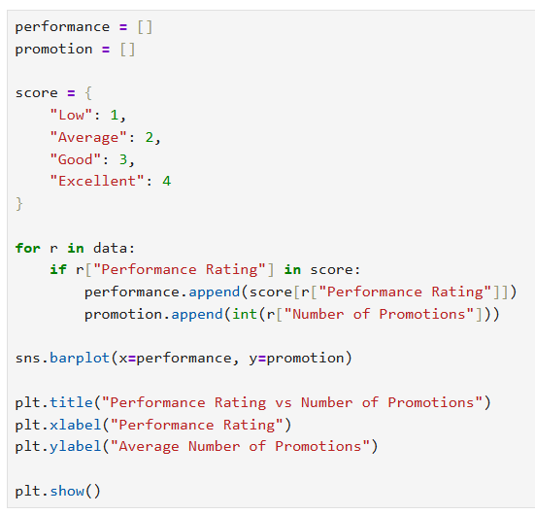
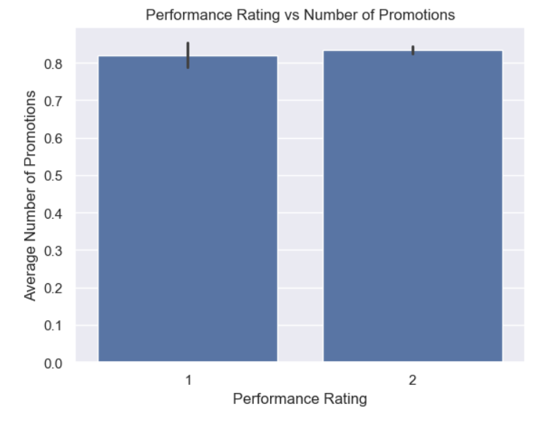

Slide 41

Create a heatmap showing correlations among numerical features.
Analysis - Multivariate
Business Insight
Since these numerical features have weak correlations, HR should consider multiple factors together instead of relying on only one variable when making decisions.
Business Conclusion
I conclude that the heatmap helps identify relationships among numerical features, and in this dataset, the variables show very weak correlations, indicating that each factor influences employee analysis independently.

Slide 42
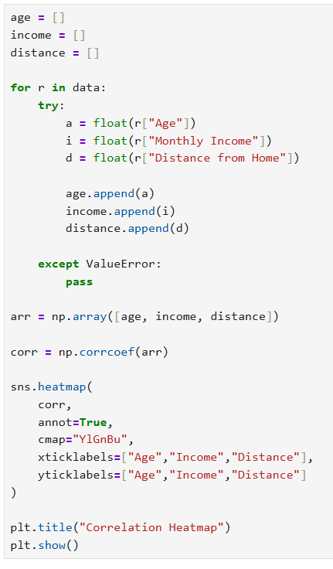
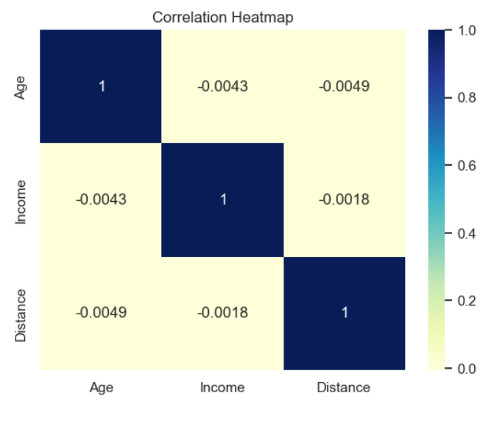

Slide 43


